Slide 1
ANGULAR WORKSHOP
16 de Noviembre de 2.018

Slide 2


Best practices in Angular
Angular CLI
Automatic Documentation
Reactive Programming

Slide 3

1. Best practices in Angular

Slide 4
Best Practices for Writing Angular Apps
Use of Angular CLI
Develop apps in modular fashion using core, shared and feature modules.
Lazy loading a feature module.
Use of smart vs presentational
Proper use of dependency injection
Aliases for imports.
Make use of lint rules
....

Slide 5

Best Pratices
Style Guide
A style guide is a set of standards for the writing and design of documents, either for general use or for a specific publication, organization, or field.
The purpose of this style guide is to provide guidance on building Angular applications by showing the conventions I use and, more importantly, why I choose them.
Jonh Papa

Slide 6
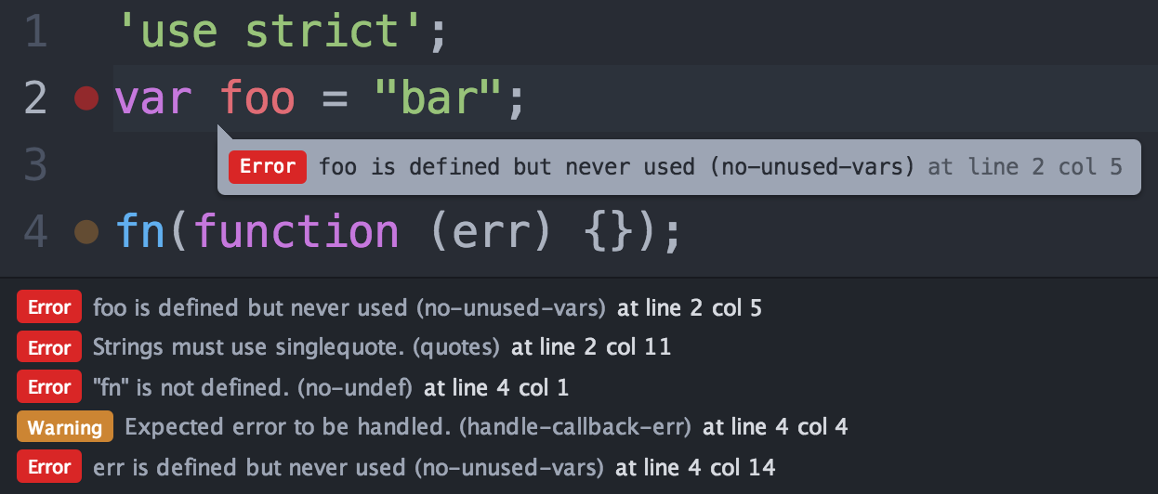
Linter
What is
A linter or lint refers to tools that analyze source code to flag programming errors, bugs, stylistic errors, and suspicious constructs.

Slide 7

Linter
Linter Rules
Make use of lint rules
Having lint rules in place means that you will get a nice error when you are doing something that you should not be. This will enforce consistency in your application and readability.

Slide 8

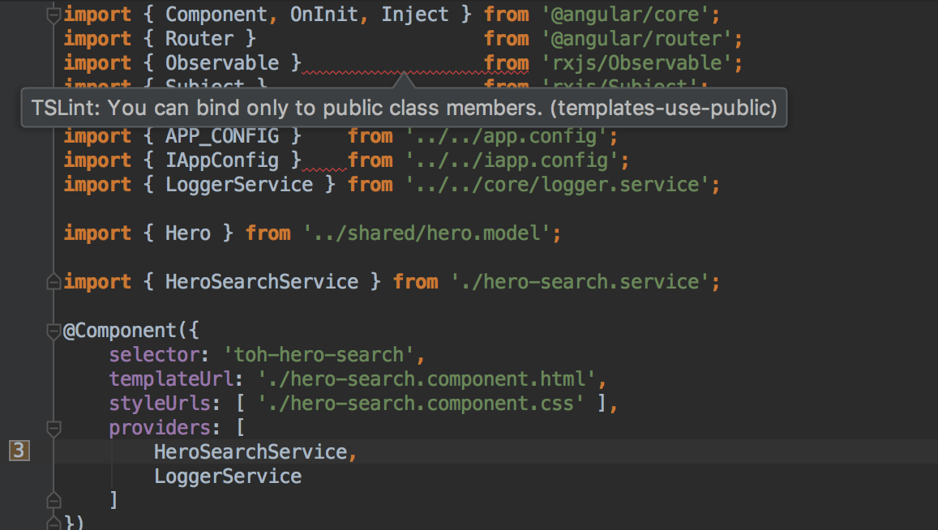
TsLint
What its
TSLint is an extensible static analysis tool that checks TypeScript code for readability, maintainability, and functionality errors.
Rules:
https://palantir.github.io/tslint/rules/

Slide 9
TypeScript-specific
These rules find errors related to TypeScript features

Slide 10
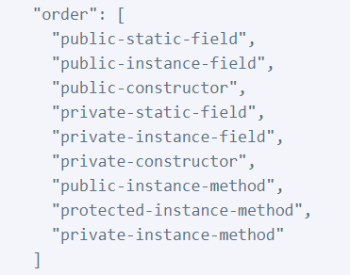
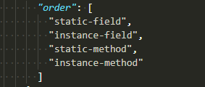
TsLint
Rule: member-ordering
Enforces member ordering.
A consistent ordering for class members can make classes easier to read, navigate, and edit.
A common opposite practice to member-ordering is to keep related groups of classes together. Instead of creating classes with multiple separate groups, consider splitting class responsibilities apart across multiple single-responsibility classes.

Slide 11
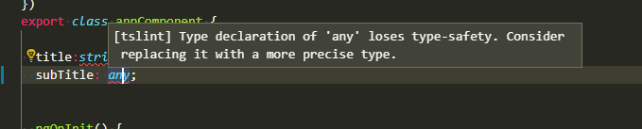
TsLint
Rule: no-any
Disallows usages of any as a type declaration.
Using any as a type declaration nullifies the compile-time benefits of the type system.

Slide 12
Maintainability
These rules make code maintenance easier

Slide 13
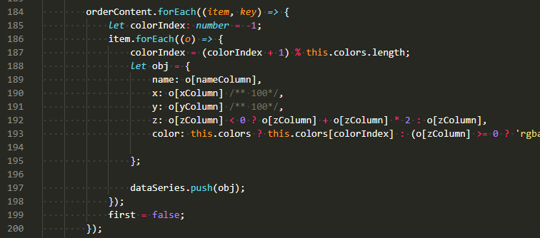
TsLint
Rule: indent
Enforces indentation with tabs or spaces.
Using only one of tabs or spaces for indentation leads to more consistent editor behavior, cleaner diffs in version control, and easier programmatic manipulation.

Slide 14
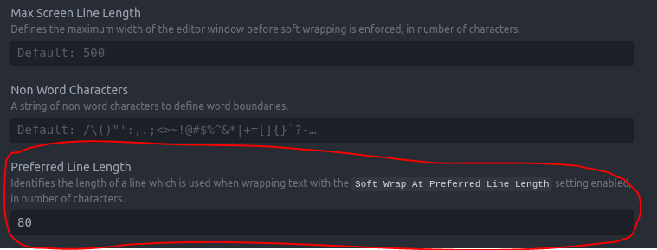
TsLint
Rule: max-line-length
Requires lines to be under a certain max length.
Limiting the length of a line of code improves code readability. It also makes comparing code side-by-side easier and improves compatibility with various editors, IDEs, and diff viewers.

Slide 15
Functionality
These rules catch common errors in JS programming or otherwise confusing constructs that are prone to producing bugs:

Slide 16
TsLint
Rule: curly
Enforces braces for if/for/do/while statements
if (foo === bar)
foo++;
bar++;
In the code above, the author almost certainly meant for both foo++ and bar++ to be executed only if foo === bar. However, they forgot braces and bar++ will be executed no matter what. This rule could prevent such a mistake.

Slide 17
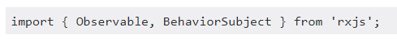

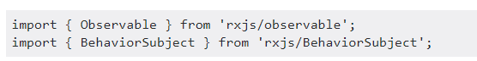
TsLint
Rule: import-blacklist
Disallows importing the specified modules directly via import and require.
Instead only sub modules may be imported from that module.
Some libraries allow importing their submodules instead of the entire module. This is good practise as it avoids loading unused modules.

Slide 18
Style
These rules enforce consistent style across your codebase:

Slide 19
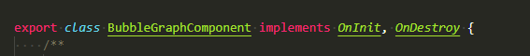
TsLint
Rule: class-name
Enforces PascalCased class and interface names..
Makes it easy to differentiate classes from regular variables at a glance.
JavaScript and general programming convention is to refer to classes in PascalCase. It’s confusing to use camelCase or other conventions for class names.

Slide 20
TsLint
Exercise
Fix Linter Errors
git clone https://github.com/rached193/AngularWorkshop-20181116/tree/master/01_best_practices/tslint
ng lint -> to excute the linter

Slide 21
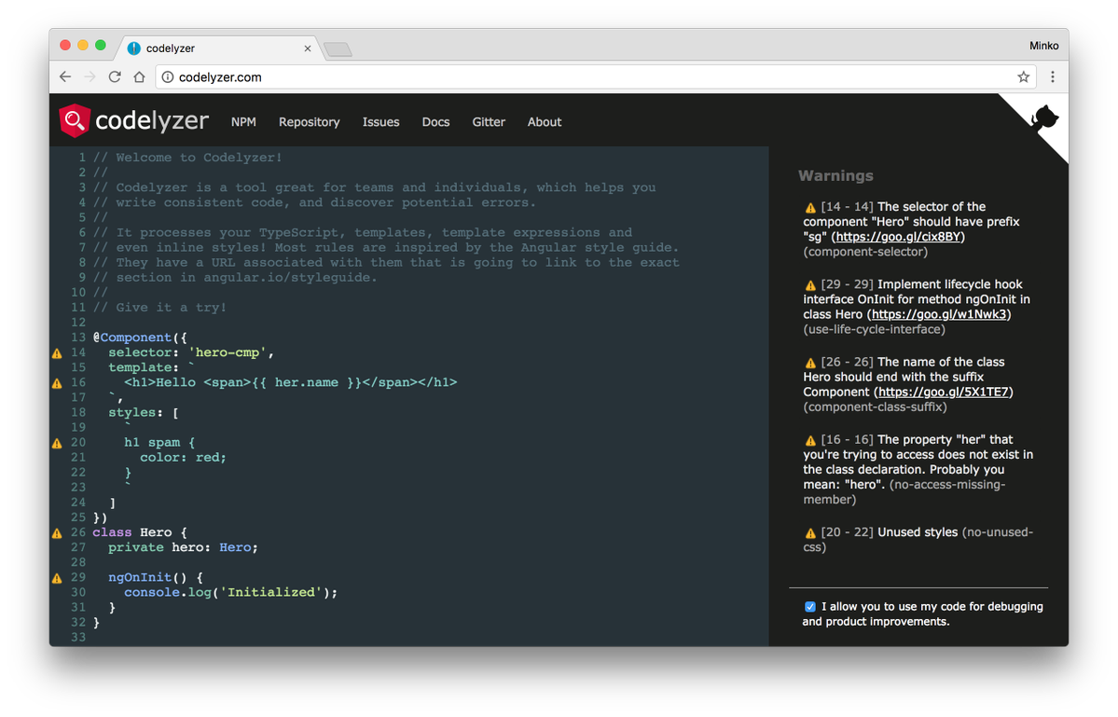

Codelyzer
What is
A set of tslint rules for static code analysis of Angular TypeScript projects.
Rules:
http://codelyzer.com/rules/

Slide 22
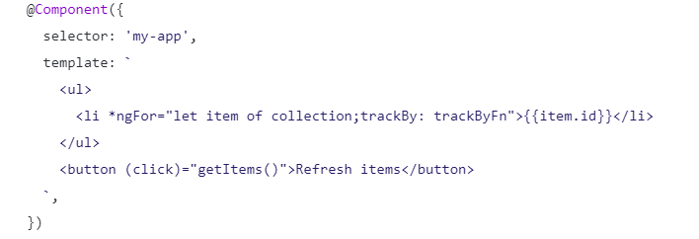
Codelyzer
Rule: trackBy-function
Ensures a TrackBy function is used.
Using TrackBy is considired as a best pratice.

Slide 23
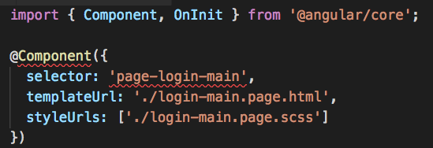
Codelyzer
Rule: component-selector
Component selectors should follow given naming rules
Consistent conventions make it easy to quickly identify and reference assets of different types.
Makes it easier to promote and share the component in other apps.
Components are easy to identify in the DOM.
Keeps the element names consistent with the specification for Custom Elements.
It is easier to recognize that a symbol is a component by looking at the template’s HTML.

Slide 24
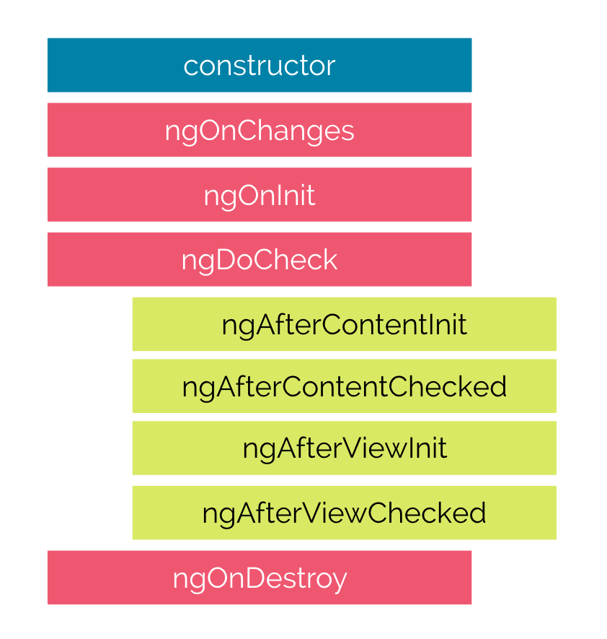
Codelyzer
Rule: use-life-cycle-interface
Ensure that components implement life cycle interfaces if they use them.
Interfaces prescribe typed method signatures.

Slide 25
Codelyzer
Exercise
Fix Codelyzer Errors
git clone https://github.com/rached193/AngularWorkshop-20181116/tree/master/01_best_practices/codelyzer
ng lint -> to excute the linter

Slide 26
Linter
Workshop
Fix APP Errors
git clone https://github.com/rached193/AngularWorkshop-20181116/tree/master/01_best_practices/workshop
Add new rules
Enforce component class sufix -> Component
Ban “console.log()”
Remove unused css
Enforce componente selector -> agenda-*
Enforce directive type -> atribute

Slide 27

¿quieres crecer con nosotros?
La información comprendida en esta presentación es confidencial y pertenece a Hiberus Tecnología.
Cualquier forma de divulgación, reproducción, copia o distribución total o parcial de la misma queda prohibida, no pudiendo ser utilizado su contenido para otros fines sin la autorización expresa por escrito de Hiberus Tecnología.
Contacto
+34 902 877 392
www.hiberus.com

